Slide 1
EEE321.LAB Introduction to communication
The following slides are prepared and Presented By:
Mohammed Mahmudur Rahman Student ID: 152 0386 043

Slide 2
What will I discuss here?
AM
FM
PM
Amplitude Modulation
Frequency Modulation
Phase Modulation

Slide 3
Amplitude Modulation(AM)
Theoretical Idea
In AM, the amplitude of the carrier signal changes in accordance with the amplitude of the input modulating signal. There should be a modulating signal. This is also called an input signal or baseband signal. This is a low-frequency signal normally. There is another high-frequency signal called carrier. The purpose of AM is to transform the low-frequency baseband signal to a higher frequency signal using the carrier.
Why we need the conversion?
High-frequency signals can be propagated over longer distances than lower frequency signals.

Slide 4
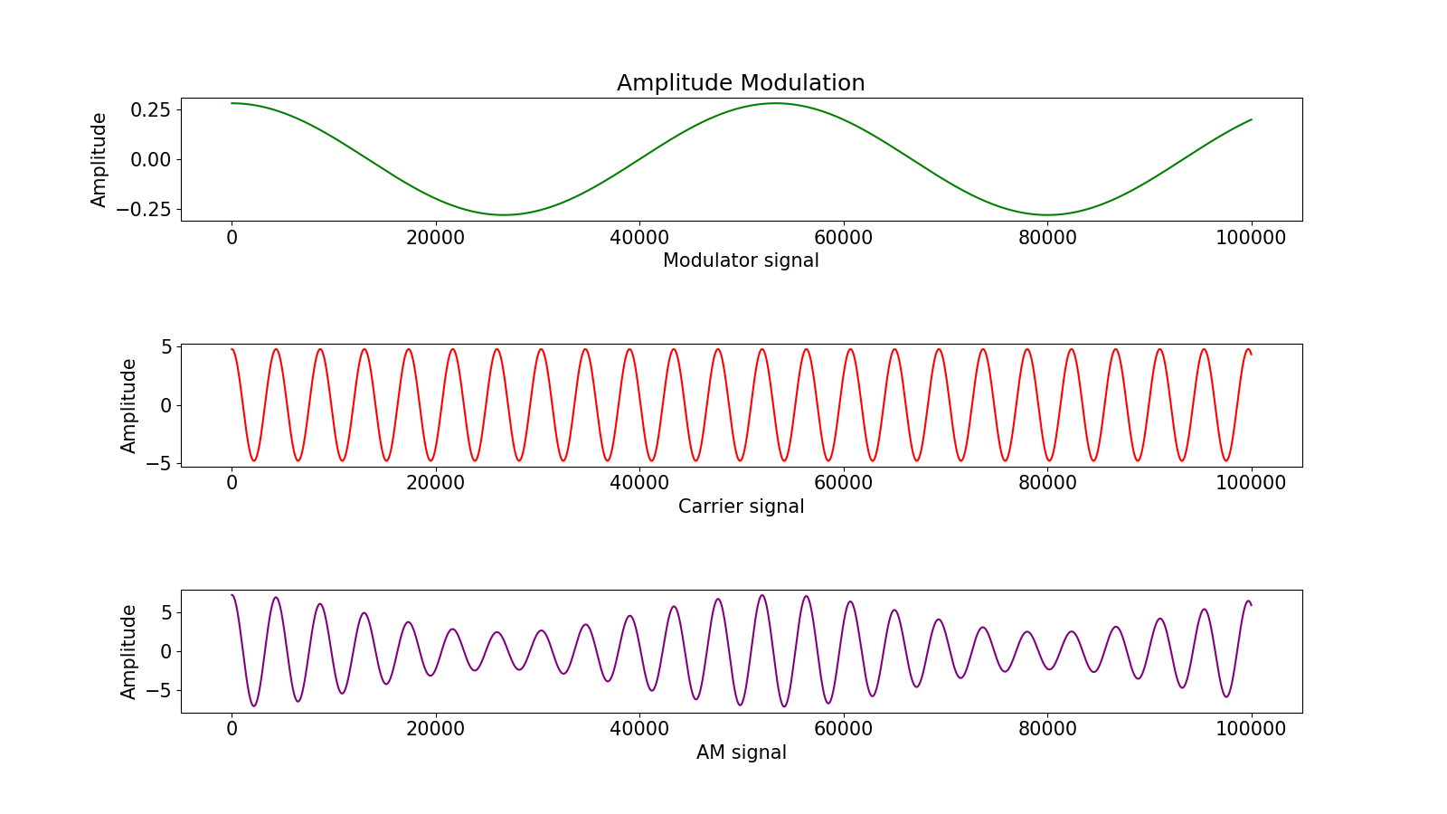
Mechanism of AM:
A
C
B
D
A
C
B
D

Slide 5
Applications of AM
AM is used for broadcasting in long wave or medium wave or short wave bands.
The Very High Frequency (VHF) transmission is processed by AM. Radio communication uses VHF.
An special type of AM is Quadrature Amplitude Modulation (QAM). It is used for data transmission from short range transmission to cellular communications.

Slide 6
Advantages & Disadvantages of AM
Advantages
Amplitude modulation is economical as well as easily obtainable
It is so simple to implement, and by using a circuit with fewer components it can be demodulated.
The receivers of AM are inexpensive because it doesn’t require any specialized components.
Disadvantages
The efficiency of this modulation is very low because it uses a lot of power
This declines the original signal quality on the receiving end & causes troubles in the signal quality.
AM systems are susceptible toward the generation of noise generation.
The applications of amplitude modulation limits to VHF, radios, & applicable one to one communication only

Slide 7
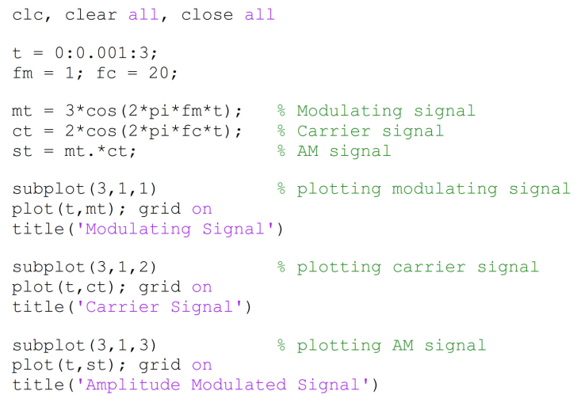
MATLAB Code

Slide 8
Frequency Modulation (FM)
Theoretical Idea
Frequency modulation uses the information signal to vary the carrier frequency within some small range about its original value. Here the only thing that changes is the frequency of the signal. Amplitude and phase remains unchanged in this process.

Slide 9
Mechanism of AM:
C
B

Slide 10
Application of FM
Telemetry, radar and seismic prospecting, EEG monitoring of new-born etc. also use the technique of frequency modulation.
Frequency modulation can be used for the broadcasting of FM radio. This helps in larger signal to noise ratio.
It is also used in music synthesis, some systems that use video-transmission and also for magnetic tape-recording systems.

Slide 11
Advantages & Disadvantages of Amplitude Modulation
Advantages
In Fm receivers noise can be reduced by increasing the frequency deviation and hence Fm reception is immune to noise as compared to AM reception
Highly efficient than AM transmitters as in Am transmission most of the power goes waste in the transmitted carrier.
FM transmission can be used for the stereo sound transmission due to a large number of side bands.
Disadvantages
The bandwidth in FM transmission is 10 times as large as that needed in AM transmission.
The area of reception for FM transmission is much smaller than that for AM transmission as the FM reception is limited to L-O-S.
The transmitting and receiving equipments are very complex in FM.

Slide 12
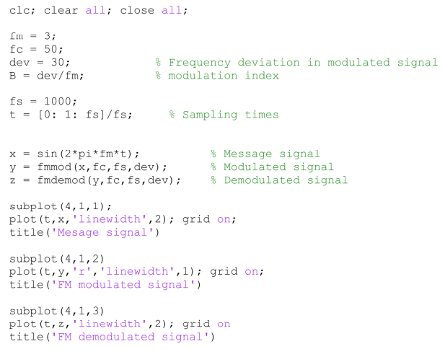
MATLAB Code

Slide 13
Phase Modulation (PM)
Theoretical Idea
Phase modulation (PM) is a modulation pattern for conditioning communication signals for transmission. It encodes a message signal as variations in the instantaneous phase of a carrier wave. The phase of a carrier signal is modulated to follow the changing signal level (amplitude) of the message signal.

Slide 14
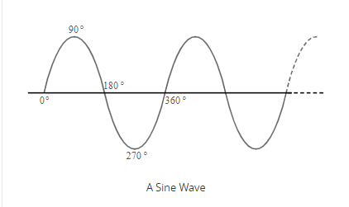
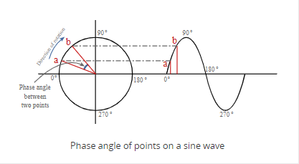
Mechanism of AM:
Before looking at phase modulation it is first necessary to look at phase itself. Lets assume, a radio frequency signal consists of an oscillating carrier in the form of a sine wave is the basis of the signal. The instantaneous amplitude follows this curve moving positive and then negative, returning to the start point after one complete cycle - it follows the curve of the sine wave.
This sine wave can also be represented by the movement of a point around a circle, the phase at any given point being the angle between the start point and the point on the waveform as shown.

Slide 15
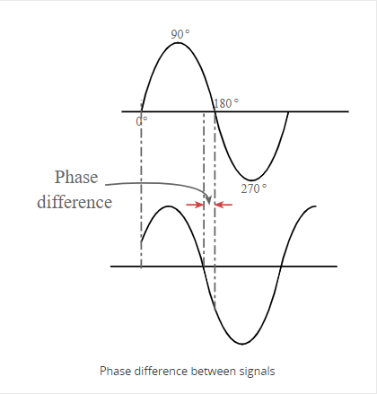
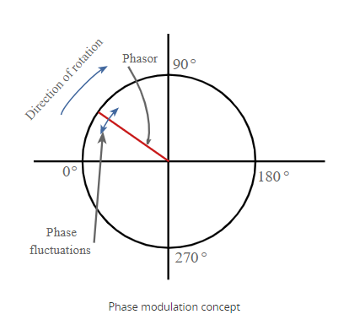
Mechanism of AM (continue)
As the phase advances as time progresses so points on the waveform can be said to have a phase difference between them.
Phase modulation works by modulating the phase of the signal, i.e. changing the rate at which the point moves around the circle. This changes the phase of the signal from what it would have been if no modulation was applied. In other words the speed of rotation around the circle is modulated about the mean value.

Slide 16
Relation between Frequency and Phase Modulation
Phase and frequency are inseparably linked as phase is the integral of frequency.
To achieve the PM, it is necessary to change the frequency of the signal for a short time. In other words, when phase modulation is applied to a signal there are frequency changes and vice versa.
Frequency modulation can be changed to phase modulation by simply adding a CR network to the modulating signal that integrates the modulating signal.

Slide 17
Application of FM
transmitting radio waves.
Digital Transmission coding schemes that underlie a wide range of technologies like WiFi, GSM and satellite television.
Signal and waveform synthesizers.

Slide 18
Advantages & Disadvantages of Amplitude Modulation
Advantages
The main benefit of this modulation is signal modulation because it permits computer for communicating on high-speed using a telephone system.
When the information is being transmitted without intrusion then the speed rates can be observed.
And one more advantage of PM (phase modulation) is improved immunity toward the noise.
Disadvantages
Phase modulation needs two signals by a phase variation among them. Through this, both the two patterns are required like a reference as well as a signal.
This type of modulation requires hardware which obtains more complex due to its conversion technique.
Phase ambiguity arrives if we exceed index pi radian of modulation (1800).
Phase modulation index can be enhanced by employing frequency multiplier.

Slide 19
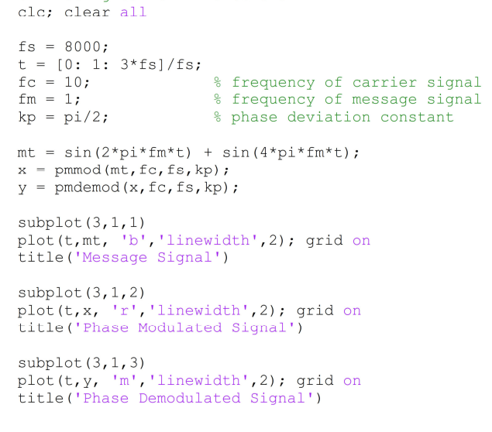
MATLAB Code

Slide 20
THANK YOU!

